Slide 1
SEQ CPU Implementation

Slide 2
Outline
SEQ Implementation
Suggested Reading 4.3.1, 4.3.4

Slide 3
What we will discuss today?
The implementation of a sequential CPU ---- SEQ
  Every Instruction finished in one cycle
  Instruction executes in sequential
  No two instruction execute in parallel or overlap

Slide 4
Computation Steps
OPl rA, rB
Fetch
icode,ifun
icode:ifun ← M₁[PC]
Read instruction byte
rA,rB
rA:rB ← M₁[PC+1]
Read register byte
valC
[Read constant word]
valP
valP ← PC+2
Compute next PC
Decode
valA, srcA
valA ← R[rA]
Read operand A
valB, srcB
valB ← R[rB]
Read operand B
Execute
valE
valE ← valB OP valA
Perform ALU operation
Cond code
Set CC
Set condition code register
Memory
valM
[Memory read/write]
Write
back
dstE
R[rB] ← valE
Write back ALU result
dstM
[Write back memory result]
PC update
PC
PC ← valP
Update PC
All instructions follow same general pattern
Differ in what gets computed on each step
Notes:
总结一下：最左边是各个阶段的名称，中间是各个阶段可能要用到的信号。最右边是OPl对这种一般化的实现。
对于中间一栏，dstE表示写寄存器时，从Execute阶段来的数据写到哪个寄存器；dstM表示从Memory阶段来的数据写到哪个寄存器。
只要是对于同一个东西，但数据来源不一致的就有一个相应的信号名字给它，同时用电路将各个输入加以合并。

Slide 5
Computation Steps
call Dest
Fetch
icode,ifun
icode:ifun ← M₁[PC]
Read instruction byte
rA,rB
[Read register byte]
valC
valC ← M₄[PC+1]
Read constant word
valP
valP ← PC+5
Compute next PC
Decode
valA, srcA
[Read operand A]
valB, srcB
valB ← R[%esp]
Read operand B
Execute
valE
valE ← valB + –4
Perform ALU operation
Cond code
[Set condition code reg.]
Memory
valM
M₄[valE] ← valP
[Memory read/write]
Write
back
dstE
R[%esp] ← valE
[Write back ALU result]
dstM
Write back memory result
PC update
PC
PC ← valC
Update PC
All instructions follow same general pattern
Differ in what gets computed on each step
Notes:
另外一个例子，call指令。

Slide 6
PC
Write back
valM
Memory
Data memory
addrs,data
valE
Cnd
CC
ALU
Execute
CC
aluA,aluB
valA, valB
Decode
srcA, srcB
A B
Register File
M
M
E
Register
icode:ifun, rA:rB
valC
dstE,dstM
valE,
valM
valP
Instruction memory
Fetch
Instruction
PC increment
PC
newPC
Notes:
一个比较怪的地方是：我们的指令执行图是从下到上的。这种设计的原因等到PIPE的实现时我们会解释的。
之所以Write back阶段和PC Update阶段要回下来，是因为他们要访问Register file和PC这两个前面阶段用过的部件。
要注意的是虽然在语义动作中说各个可能写状态的阶段写状态的动作是顺序发生的。但实际上对于硬件来说，它们是同时在clock rising的时候发生的。

Slide 7
Computed Values
Fetch
  icode Instruction code
  ifun Instruction function
  rA Instr. Register A
  rB Instr. Register B
  valC Instruction constant
  valP Incremented PC
Decode § Write back
  valA Register value A
  valB Register value B
Execute
  valE ALU result
  Bch Branch flag
Memory
  valM Value from memory

Slide 8
SEQ Semantics
Achieve the same effect as a sequential execution of the assignment shown in the tables of Figures 4.18 to 4.21
  Though all of the state updates occur simultaneously at the clock rises to the next cycle.
  A problem: popl %esp need to sequentially write two registers. So the register file control logic must process it.
Notes:
这里说的state update并不是指内部信号，而是指那些外部可见的那些CPU状态。
如果这条原则被违反，那么已pushl指令为例，写esp必须在这个cycle中出现，因为如果在上跳沿出现，那么读取esp的操作就必须在下一个cycle才能进行。这就使得一条指令执行了两个cycle。
这条原则事实上没有什么太大的限制，因为如果需要读取当前cycle更新的寄存器，那么这个值必然在某根信号线上存在着。所以也就不需要读取寄存器。
所以，指令的语义设计时可以克服这一限制。
这个原则主要是针对指令语义设计而来的。

Slide 9
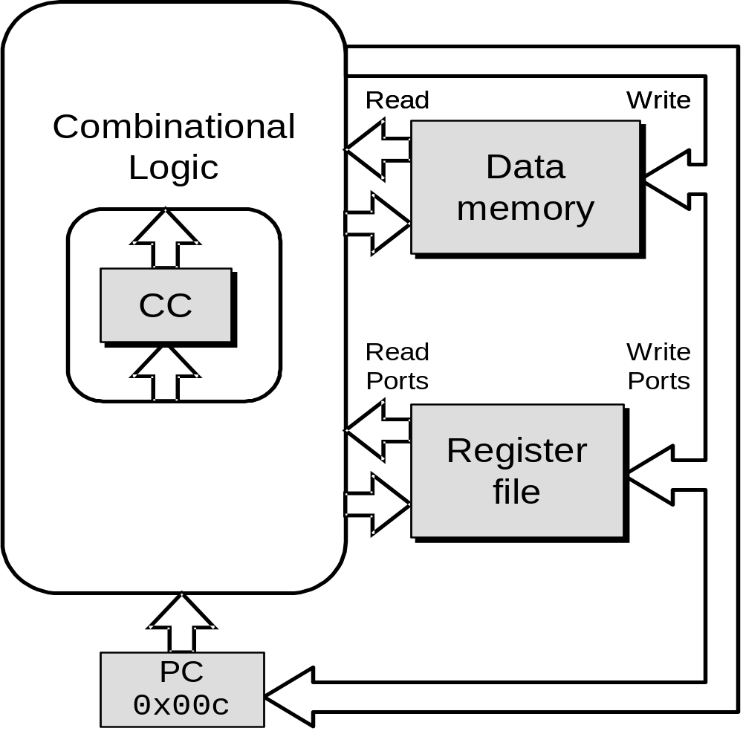
SEQ Operation
State
  Program counter register (PC)
  Condition code register (CC)
  Register File
  Memories
    Access same memory space
    Data: for reading/writing program data
    Instruction: for reading instructions
  All updated as clock rises

Slide 10
SEQ Operation
Combinational Logic
  ALU
  Control logic
  Memory reads
    Instruction memory
    Register file
    Data memory

Slide 11
SEQ Operation #2
Cycle 1
Cycle 2
Cycle 3
Cycle 4
Clock
Cycle 1:
0x000:
irmovl
$0x100,%
ebx
# %
ebx
<
--
0x100
Cycle 2:
0x006:
irmovl
$0x200,%
edx
# %
edx
<
--
0x200
Cycle 3:
0x00c:
addl
%
edx
,%
ebx
# %
ebx
<
--
0x300 CC <
--
000
Cycle 4:
0x00e:
je dest
# Not taken
Notes:
What will happen after the end of second execution cycle.

Slide 12
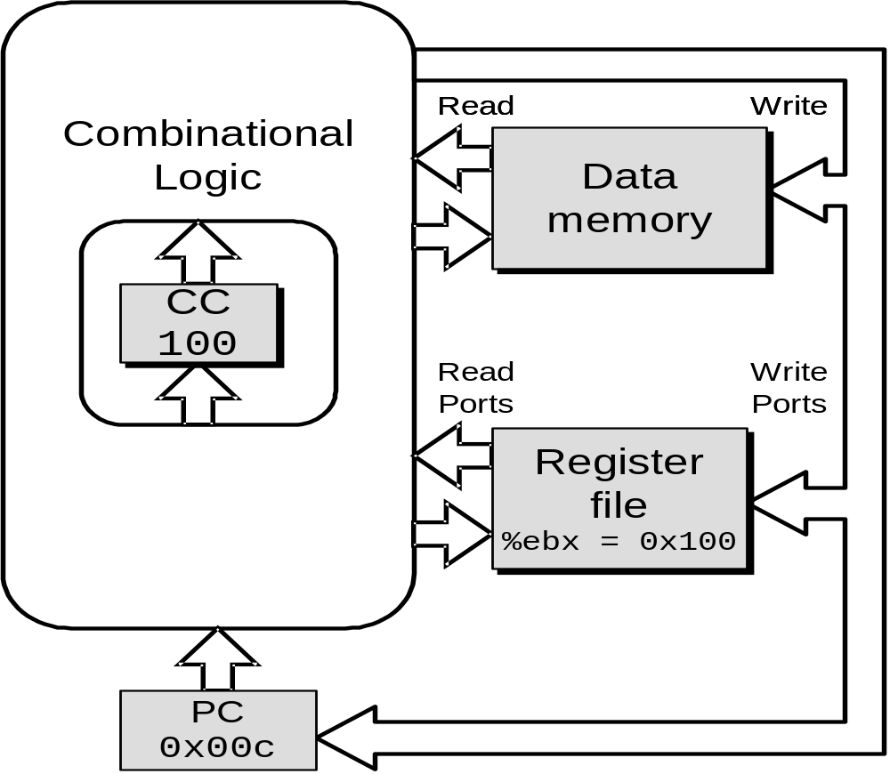
SEQ Operation #2
state set according to second irmovl instruction
combinational logic starting to react to state changes

Slide 13
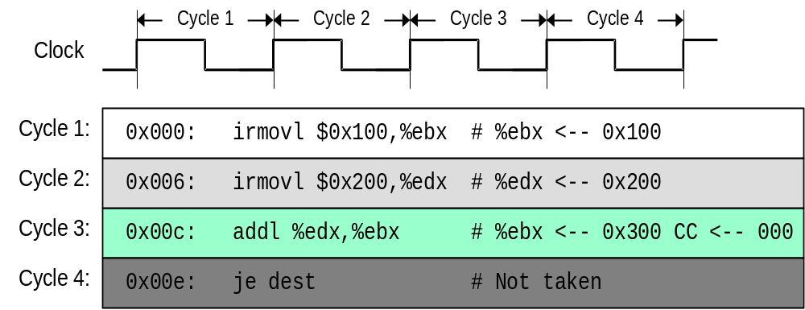
SEQ Operation #3
Notes:
What will happen before the end of the third execution cycle.

Slide 14
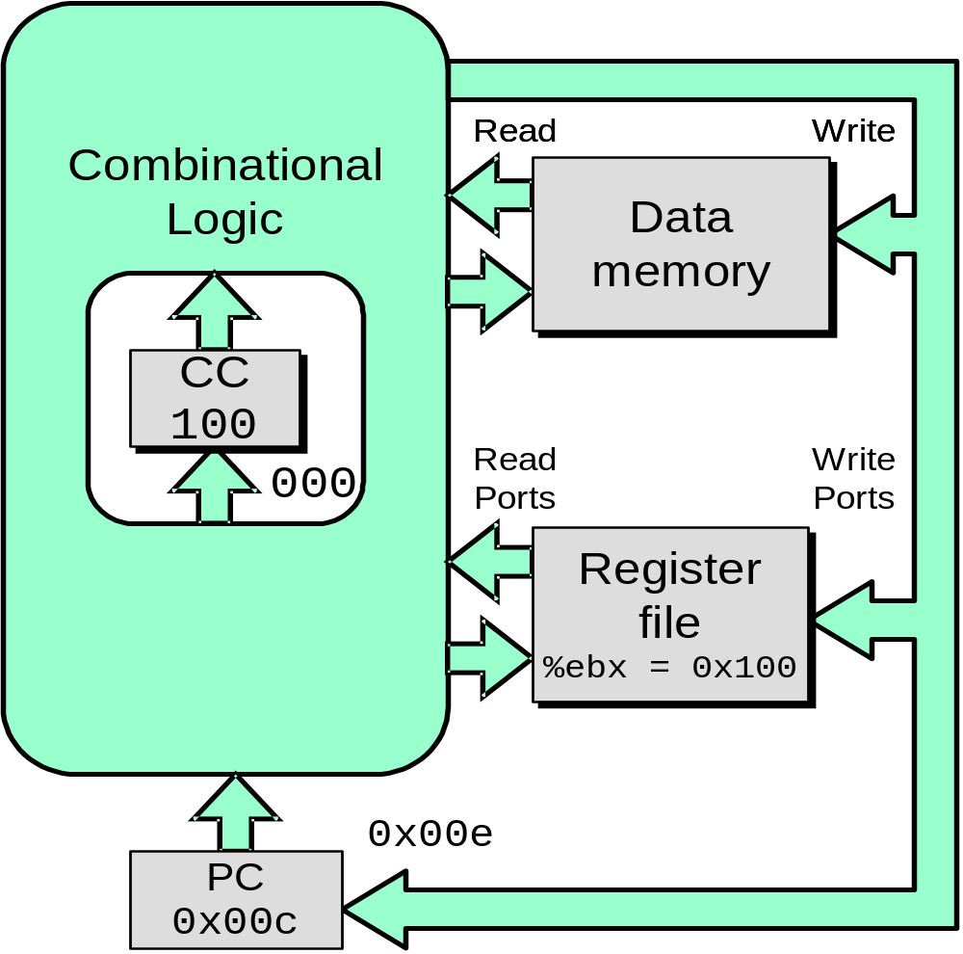
SEQ Operation #3
state set according to second irmovl instruction
combinational logic generates results for addl instruction
0x300

Slide 15
SEQ Operation #4

Slide 16
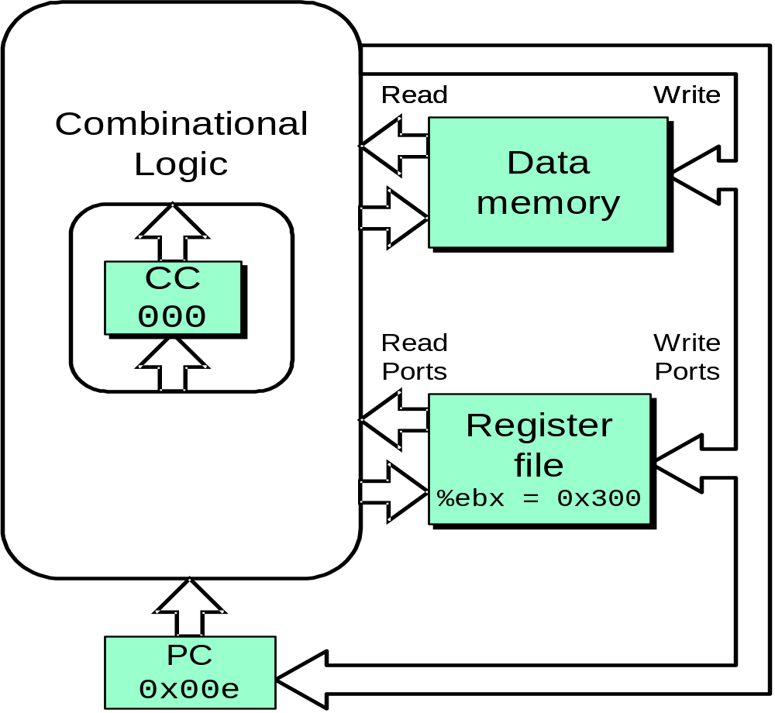
SEQ Operation #4
state set according to addl instruction
combinational logic starting to react to state changes

Slide 17
SEQ Operation #5

Slide 18
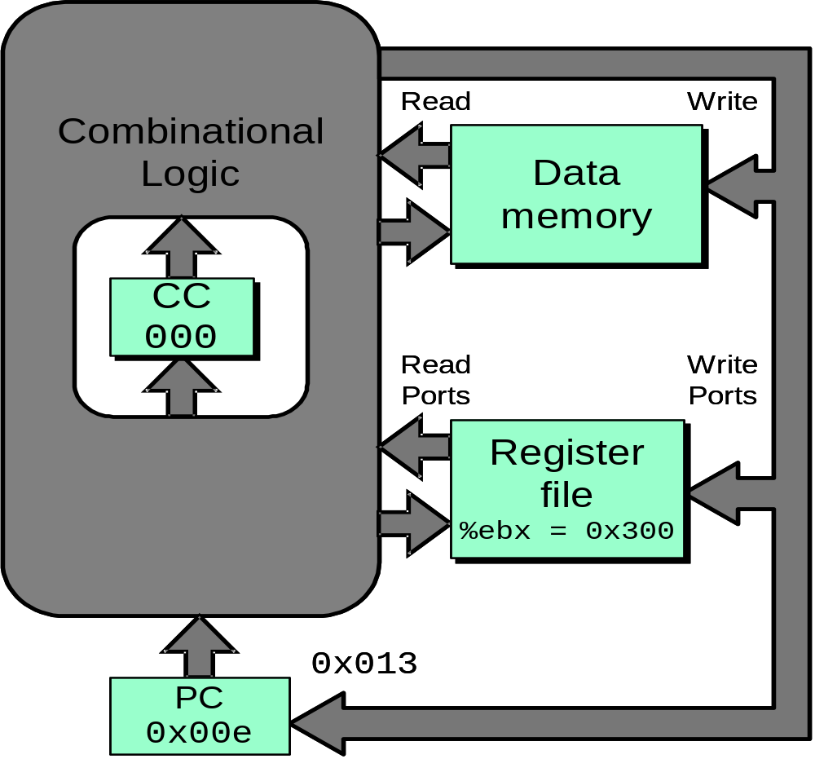
SEQ Operation #5
state set according to addl instruction
combinational logic generates results for je instruction

Slide 19
SEQ Hardware Structure
Stages
  Fetch: Read instruction from memory
  Decode: Read program registers
  Execute: Compute value or address
  Memory: Read or write data
  Write Back: Write program registers
  PC: Update program counter
Notes:
一个比较怪的地方是：我们的指令执行图是从下到上的。这种设计的原因等到PIPE的实现时我们会解释的。
之所以Write back阶段和PC Update阶段要回下来，是因为他们要访问Register file和PC这两个前面阶段用过的部件。
要注意的是虽然在语义动作中说各个可能写状态的阶段写状态的动作是顺序发生的。但实际上对于硬件来说，它们是同时在clock rising的时候发生的。

Slide 20
SEQ Hardware Structure
Instruction Flow
  Read instruction at address specified by PC
  Process through stages
  Update program counter
Notes:
一个比较怪的地方是：我们的指令执行图是从下到上的。这种设计的原因等到PIPE的实现时我们会解释的。
之所以Write back阶段和PC Update阶段要回下来，是因为他们要访问Register file和PC这两个前面阶段用过的部件。
要注意的是虽然在语义动作中说各个可能写状态的阶段写状态的动作是顺序发生的。但实际上对于硬件来说，它们是同时在clock rising的时候发生的。

Slide 21
PC
Write back
valM
Memory
Data memory
addrs,data
valE
Cnd
CC
ALU
Execute
CC
aluA,aluB
valA, valB
Decode
srcA, srcB
A B
Register File
M
M
E
Register
icode:ifun, rA:rB
valC
dstE,dstM
valE,
valM
valP
Instruction memory
Fetch
Instruction
PC increment
PC
newPC
Notes:
一个比较怪的地方是：我们的指令执行图是从下到上的。这种设计的原因等到PIPE的实现时我们会解释的。
之所以Write back阶段和PC Update阶段要回下来，是因为他们要访问Register file和PC这两个前面阶段用过的部件。
要注意的是虽然在语义动作中说各个可能写状态的阶段写状态的动作是顺序发生的。但实际上对于硬件来说，它们是同时在clock rising的时候发生的。

Slide 22
Difference between semantics and implementation
ISA
  Every stage may update some states, these updates occur sequentially
SEQ
  All the state update operations occur simultaneously at clock rising

Slide 23
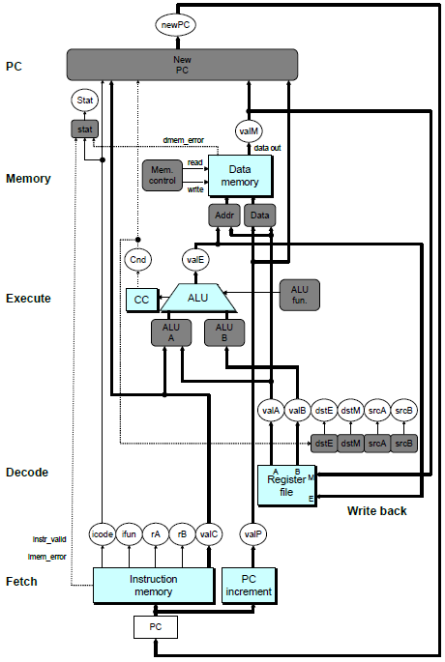
SEQ Hardware
Blue boxes: predesigned hardware blocks
  E.g., memories, ALU
Gray boxes: control logic
  Describe in HCL
White ovals: labels for signals
Thick lines: 32-bit word values
Thin lines: 4-8 bit values
Dotted lines: 1-bit values

Slide 24
Some Macros
Name | Value | Meaning
INOP | 0 | Code for nop instruction
IHALT | 1 | Code for halt instruction
IRRMOVL | 2 | Code for rrmovl instruction
IIRMOVL | 3 | Code for irmovl instruction
IRMMOVL | 4 | Code for rmmovl instruction
IMRMOVL | 5 | Code for mrmovl instruction
IOPL | 6 | Code for integer op instructions
IJXX | 7 | Code for jump instructions
………… | …… | ……………………………
IPOPL | B | Code for popl instruction
Notes:
用在HCL中表示指令、寄存器、操作符类型，由于电路中只有数字信号，因此在HCL中，我们定义一些macros来帮助记忆

Slide 25
Some Macros
Name | Value | Meaning
RESP | 4 | Register ID for %esp
RNONE | F | Indicates no register file access
ALUADD | 0 | Function for addition operation
Notes:
用在HCL中表示指令、寄存器、操作符类型

Slide 26
Fetch Logic
icode
ifun
rA
rB
valC
valP
Need
valC
PC
increment
Instr
valid
Need
regids
icode
ifun
Split
Align
Byte 0
Bytes 1-5
Instruction
memory
imem_error
PC
Notes:
事实上，不管需要几个字节，读入都是6个字节。
Split实际上是非常简单的。因为读出的一个字节就是8根信号线，只要将他们分为两股就可以了。
一个问题：Align没有使用Need valC信号，因为如果这条指令没有带常数，那么valC不管产生什么内容都无所谓。但valC到底是1-4字节还是2-5字节却要根据Need regids信号来确定。所以Need regids必须要，而Need valC可以不需要。
这也是一种常用的硬件设计方法：如果我们说一个信号在某种情况下用不到，那么它就可以是任意值。这样通过对它赋予某种赋值可以将他与其他信号合并或者其他简化。这里就是一个例子，valC并不是如果不需要的话，就为0。

Slide 27
Fetch Logic
icode
ifun
rA
rB
valC
valP
Need
valC
PC
increment
Instr
valid
Need
regids
icode
ifun
Split
Align
Byte 0
Bytes 1-5
Instruction
memory
imem_error
Predefined Blocks
  PC: Register containing PC
  Instruction memory: Read 6 bytes (PC to PC+5)
  Split: Divide instruction byte into icode and ifun
  Align: Get fields for rA, rB, and valC
PC
Notes:
事实上，不管需要几个字节，读入都是6个字节。
Split实际上是非常简单的。因为读出的一个字节就是8根信号线，只要将他们分为两股就可以了。
一个问题：Align没有使用Need valC信号，因为如果这条指令没有带常数，那么valC不管产生什么内容都无所谓。但valC到底是1-4字节还是2-5字节却要根据Need regids信号来确定。所以Need regids必须要，而Need valC可以不需要。
这也是一种常用的硬件设计方法：如果我们说一个信号在某种情况下用不到，那么它就可以是任意值。这样通过对它赋予某种赋值可以将他与其他信号合并或者其他简化。这里就是一个例子，valC并不是如果不需要的话，就为0。

Slide 28
Fetch Logic
icode
ifun
rA
rB
valC
valP
Need
valC
PC
increment
Instr
valid
Need
regids
icode
ifun
Split
Align
Byte 0
Bytes 1-5
Instruction
memory
imem_error
Control Logic
  Instr. Valid: Is this instruction valid?
  Need regids: Does this instruction have a register bytes?
  Need valC: Does this instruction have a constant word?
PC
Notes:
事实上，不管需要几个字节，读入都是6个字节。
Split实际上是非常简单的。因为读出的一个字节就是8根信号线，只要将他们分为两股就可以了。
一个问题：Align没有使用Need valC信号，因为如果这条指令没有带常数，那么valC不管产生什么内容都无所谓。但valC到底是1-4字节还是2-5字节却要根据Need regids信号来确定。所以Need regids必须要，而Need valC可以不需要。
这也是一种常用的硬件设计方法：如果我们说一个信号在某种情况下用不到，那么它就可以是任意值。这样通过对它赋予某种赋值可以将他与其他信号合并或者其他简化。这里就是一个例子，valC并不是如果不需要的话，就为0。

Slide 29
Fetch Control Logic in HCL
# Determine instruction code
int icode = [
imem_error: INOP;
1: imem_icode;
];
# Determine instruction function
int ifun = [
imem_error: FNONE;
1: imem_ifun;
];
icode
ifun
Split
Byte 0
Instruction
memory
imem_error
PC
Notes:
这里，我们假定在HCL和信号之间的关系确定之后，EDA(Electronic Design Automation)工具会自动生成电路

Slide 30
Fetch Control Logic in HCL
halt
0
0
nop
1
0
cmovXX rA, rB
2
fn
rA
rB
irmovl V, rB
3
0
F
rB
V
rmmovl rA, D(rB)
4
0
rA
rB
D
mrmovl D(rB), rA
5
0
rA
rB
D
OPl rA, rB
6
fn
rA
rB
jXX Dest
7
fn
Dest
call Dest
8
0
Dest
ret
9
0
pushl rA
A
0
rA
F
popl rA
B
0
rA
F
bool need_regids =
icode in { IRRMOVL, IOPL, IPUSHL, IPOPL,
IIRMOVL, IRMMOVL, IMRMOVL };
bool instr_valid = icode in
{ INOP, IHALT, IRRMOVL, IIRMOVL, IRMMOVL, IMRMOVL,
IOPL, IJXX, ICALL, IRET, IPUSHL, IPOPL };

Slide 31
Decode & Write-Back Logic
Register File
  Read ports A, B
  Write ports E, M
  Addresses are register IDs or 15 (0xF) (no access)
Cnd
valA
valB
valM
valE
A
B
Register
file
M
dstE
dstM
srcA
E
srcB
Control Logic
  srcA, srcB: read port addresses
  dstE, dstM: write port addresses
dstE
dstM
srcA
srcB
icode
rA
rB
Signals
  Cnd: Indicate whether or not to perform conditional move
    Computed in Execute stage
Notes:
因为decode和write back都要对寄存器进行操作，因此我们将它们合并在一起

Slide 32
A Source
OPl rA, rB
Decode
valA ← R[rA]
Read operand A
cmovXX rA, rB
Decode
valA ← R[rA]
Read operand A
rmmovl rA, D(rB)
Decode
valA ← R[rA]
Read operand A
popl rA
Decode
valA ← R[%esp]
Read stack pointer
jXX Dest
Decode
No operand
call Dest
Decode
No operand
ret
Decode
valA ← R[%esp]
Read stack pointer
int srcA = [
icode in { IRRMOVL, IRMMOVL, IOPL, IPUSHL } : rA;
icode in { IPOPL, IRET } : RESP;
1 : RNONE; # Don't need register
];
Notes:
先看decode

Slide 33
E Desti- nation
OPl rA, rB
Write-back
R[rB] ← valE
Write back result
cmovXX rA, rB
Conditionally write back result
Write-back
R[rB] ← valE
rmmovl rA, D(rB)
Write-back
None
popl rA
Write-back
R[%esp] ← valE
Update stack pointer
jXX Dest
Write-back
None
call Dest
Write-back
R[%esp] ← valE
Update stack pointer
ret
Write-back
R[%esp] ← valE
Update stack pointer
int dstE = [
icode in { IRRMOVL } && Cnd : rB;
icode in { IIRMOVL, IOPL} : rB;
icode in { IPUSHL, IPOPL, ICALL, IRET } : RESP;
1 : RNONE; # Don't write any register
];
Notes:
再看write back

Slide 34
Execute Logic
Cnd
valE
cond
ALU
ALU
fun.
CC
Set
CC
ALU
A
ALU
B
icode
ifun
valC
valA
valB
Notes:
Set CC信号表示CC寄存器是否需要被更新。

Slide 35
Execute Logic (Units)
ALU
  Implements 4 required functions
  Generates condition code values
CC
  Register with 3 condition code bits
cond
  Computes conditional jump/move flag
Notes:
Set CC信号表示CC寄存器是否需要被更新。

Slide 36
Execute Logic (Control Logic)
Set CC: Should condition code register be loaded?
ALU A: Input A to ALU
ALU B: Input B to ALU
ALU fun: What function should ALU compute?
Notes:
Set CC信号表示CC寄存器是否需要被更新。

Slide 37
ALU A Input
OPl rA, rB
Execute
valE ← valB OP valA
Perform ALU operation
cmovXX rA, rB
Execute
valE ← 0 + valA
Pass valA through ALU
rmmovl rA, D(rB)
Execute
valE ← valB + valC
Compute effective address
popl rA
Execute
valE ← valB + 4
Increment stack pointer
jXX Dest
Execute
No operation
call Dest
Execute
valE ← valB + –4
Decrement stack pointer
ret
Execute
valE ← valB + 4
Increment stack pointer
Notes:
对应的，ALU B也可以找出来，这里就是valB和0

Slide 38
ALU A Input
int aluA = [
icode in { IRRMOVL, IOPL } : valA;
icode in { IIRMOVL, IRMMOVL,IMRMOVL} : valC;
icode in { ICALL, IPUSHL } : -4;
icode in { IRET, IPOPL } : 4;
# Other instructions don't need ALU
];

Slide 39
ALU Operation
OPl rA, rB
Execute
valE ← valB OP valA
Perform ALU operation
cmovXX rA, rB
Execute
valE ← 0 + valA
Pass valA through ALU
rmmovl rA, D(rB)
Execute
valE ← valB + valC
Compute effective address
popl rA
Execute
valE ← valB + 4
Increment stack pointer
jXX Dest
Execute
No operation
call Dest
Execute
valE ← valB + –4
Decrement stack pointer
ret
Execute
valE ← valB + 4
Increment stack pointer

Slide 40
ALU Operation
int alufun = [
icode == IOPL : ifun;
1 : ALUADD;
];

Slide 41
Condition Set
Bool set_cc = icode in { IOPL };
Notes:
只有OPl指令需要设置cc寄存器。

Slide 42
Memory Logic
Memory
  Reads or writes memory word
Control Logic
  stat: What is instruction status?
  Mem. read: should word be read?
  Mem. write: should word be written?
  Mem. addr.: Select address
  Mem. data.: Select data
Stat
stat
valM
dmem_error
data out
instr_valid
Mem.
read
read
Data
memory
imem_error
Mem.
write
write
data in
Mem.
addr
Mem.
data
icode
valE
valA
valP

Slide 43
Instruction Status
Stat
Control Logic
  stat: What is instruction status?
stat
valM
dmem_error
data out
instr_valid
Mem.
read
read
Data
memory
imem_error
Mem.
write
write
data in
Mem.
addr
Mem.
data
## Determine instruction status
int Stat = [
imem_error || dmem_error : SADR;
!instr_valid: SINS;
icode == IHALT : SHLT;
1 : SAOK;
];
icode
valE
valA
valP

Slide 44
Memory Address
OPl rA, rB
Memory
No operation
rmmovl rA, D(rB)
Memory
M₄[valE] ← valA
Write value to memory
popl rA
Memory
valM ← M₄[valA]
Read from stack
jXX Dest
Memory
No operation
call Dest
Memory
M₄[valE] ← valP
Write return value on stack
ret
Memory
valM ← M₄[valA]
Read return address

Slide 45
Memory Address
int mem_addr = [
icode in { IRMMOVL, IPUSHL, ICALL, IMRMOVL } : valE;
icode in { IPOPL, IRET } : valA;
# Other instructions don't need address
];

Slide 46
Memory Read
opl rA, rB
Memory
No operation
rmmovl rA, D(rB)
Memory
M₄[valE] ← valA
Write value to memory
popl rA
Memory
valM ← M₄[valA]
Read from stack
jXX Dest
Memory
No operation
call Dest
Memory
M₄[valE] ← valP
Write return value on stack
ret
Memory
valM ← M₄[valA]
Read return address

Slide 47
Memory Read
bool mem_read = icode in { IMRMOVL, IPOPL, IRET };
bool mem_write = icode in { IRMMOVL, IPUSHL, ICALL };
Notes:
Which instructions involve memory read or memory write.

Slide 48
PC Update Logic
New PC
  Select next value of PC
PC
New
PC
icode
Cnd
valC
valM
valP

Slide 49
PC Update
OPl rA, rB
PC update
PC ← valP
Update PC
rmmovl rA, D(rB)
PC update
PC ← valP
Update PC
popl rA
PC update
PC ← valP
Update PC
jXX Dest
PC update
PC ← Cnd ? valC : valP
Update PC
call Dest
PC update
PC ← valC
Set PC to destination
ret
PC update
PC ← valM
Set PC to return
address

Slide 50
PC Update
int new_pc = [
icode == ICALL : valC;
icode == IJXX && Cnd : valC;
icode == IRET : valM;
1 : valP;
];

Slide 51
newPC
New PC
PC
data out
valM
read
Mem Control
Data memory
Memory
write
Addr
Data
Cnd
valE
Execute
CC
ALU
ALU fun
ALUA
ALUB
valA
valB
dstE
dstM
srcA
srcB
Decode
dstE
dstM
srcA
srcB
A
B
M
Register file
E
Write Back
icode
ifun
rA
rB
valC
valP
Instruction Memory
PC increment
Fetch
PC

Slide 52
SEQ Summary
Implementation
  Express every instruction as series of simple steps
  Follow same general flow for each instruction type
  Assemble registers, memories, predesigned combinational blocks
  Connect with control logic

Slide 53
SEQ Summary
Limitations
  Too slow to be practical
  In one cycle, must propagate through instruction memory, register file, ALU, and data memory
  Would need to run clock very slowly
  Hardware units only active for fraction of clock cycle

Slide 54
Next
General Principles of Pipelining
Naïve PIPE Implementation
Suggested Reading 4.4, 4.5

